Slide 1
Scrum

Slide 2
Watch this vid, now, and at home.
I think they are missing a clear “product vision” first step. The elevator pitch you would give to someone investing in the company. This feeds into the Product Owners role to articulate features that go into the Product Backlog. I will require your project to have one.
https://www.youtube.com/watch?v=9TycLR0TqFA
(We are not going to use their product “Uzility”)

Slide 3
Architect role
Also does not mention a role of “Architect”.
Often based on many factors, a project will choose a particular design technology, such as,
Client Code: React
Server Code: node.js
Storage Technology: SQL
Security Design
Generally there is an experienced team member who drives these choices, and ensures the sprints implement these technologies in an efficient, secure many. She/he is paid better, and is held responsible that the large scale design choices pan out.

Slide 4
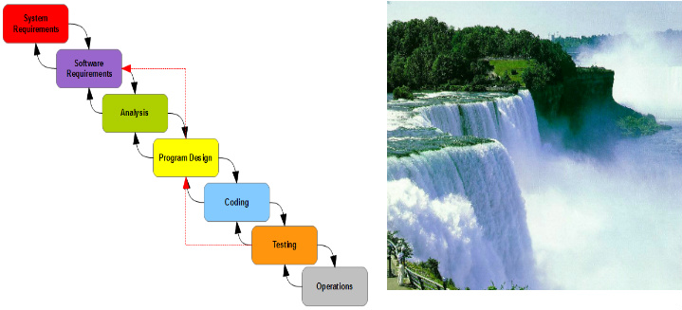
Winston Royce's Waterfall Model
Much of this come from this article
https://www.codeproject.com/Articles/604417/Agile-software-development-methodologies-and-how-t

Slide 5
Manifesto for Agile Software Development
We are uncovering better ways of developing software by doing it and helping others do it. Through this work we have come to value:
Individuals and interactions over processes and tools
Working software over comprehensive documentation
Customer collaboration over contract negotiation
Responding to change over following a plan
That is, while there is value in the items on the right, we value the items on the left more.

Slide 6
Twelve principles behind the Agile Manifesto Ref: agilemanifesto.org
Our highest priority is to satisfy the customer through early and continuous delivery of valuable software.
Welcome changing requirements, even late in development. Agile processes harness change for the customer's competitive advantage.
Deliver working software frequently, from a couple of weeks to a couple of months, with a preference to the shorter timescale.
Business people and developers must work together daily throughout the project.
Build projects around motivated individuals. Give them the environment and support they need, and trust them to get the job done.
The most efficient and effective method of conveying information to and within a development team is face-to-face conversation.
Working software is the primary measure of progress.
Agile processes promote sustainable development. The sponsors, developers, and users should be able to maintain a constant pace indefinitely.
Continuous attention to technical excellence and good design enhances agility.
Simplicity--the art of maximizing the amount of work not done--is essential.
The best architectures, requirements, and designs emerge from self-organizing teams.
At regular intervals, the team reflects on how to become more effective, then tunes and adjusts its behavior accordingly.

Slide 7
We will use these Scrum roles for producing the product:
ScrumMaster: Accountable for removing impediments to the ability of the team to deliver the sprint deliverables. Ensures that the Scrum process is used as intended. Enforcer of rules. Excludes any additional people responsibilities.
Product Owner: The Product Owner represents the stakeholders and is the voice of the customer. Accountable for ensuring value to the business. Writes (or the team) customer-centric items (user stories), prioritizes them, and adds them to the product backlog.
GitHub master: Responsible for all work done on GitHub. Creates first repo as Master, creates sprint branches, pulls branches back up into Master.
Development Team: Responsible for delivering potentially shippable product increments at the end of each Sprint. Made up of 3–9 people with cross-functional skills who do the actual work (analyze, design, develop, test, technical communication, document, etc.). Self-organizing.
Architect: This may be a non-rotating role, or a shared responsibility, but it needs to be documented
Stakeholders: Who cares about this product? Usually this is the targeted customers
Managers: Managers!

Slide 8
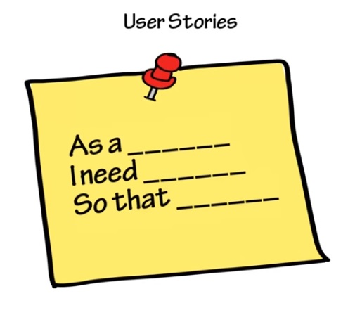
You must define your requirements using User Stories and your user stories must follow this format

Slide 9
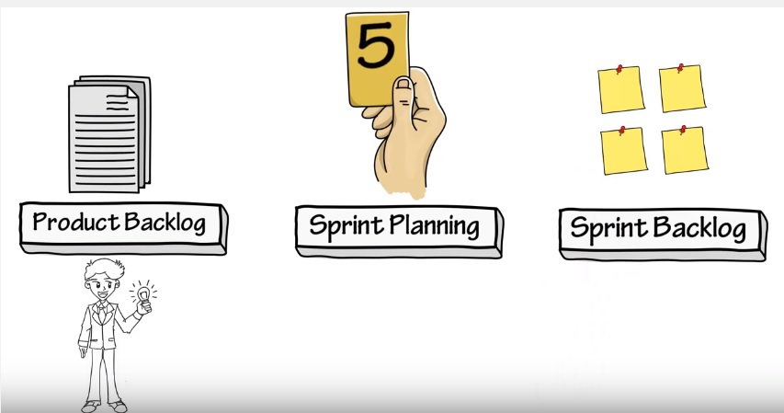
For each Sprint, we go thru these operations.
Add or Remove
Pick some for this Sprint
Update status as items completed

Slide 10
